Slide 1
Building A Simple MVC-CRUD Web Application
V A M S H I

Slide 2
INTRODUCTION
Welcome to our presentation on "Building a Simple CRUD Web Application using Java Servlets and JSP.
CRUD stands for Create, Read, Update, and Delete, which are the fundamental operations for managing data in a database.
Today, we will demonstrate how to create a web application that allows users to perform these CRUD operations on a database.
We will be using Java Servlets and JSP (JavaServer Pages) as our primary technologies for this demonstration.
So, let's dive in and explore the process of building this web application step by step.

Slide 3
Technologies Used
In this project, we will be utilizing the following technologies:
1.Java Servlets:
• Used for handling server-side requests and generating responses.
• Responsible for processing HTTP requests from clients.
2.JSP (JavaServer Pages):
• Used for creating dynamic HTML pages with embedded Java code.
• Enables the generation of dynamic content for the web application.

Slide 4
3.MySQL:
•Serves as the database management system.
•Responsible for storing and managing the application's data.
4.JDBC (Java Database Connectivity):
•Java API used for connecting and interacting with the MySQL database.
•Facilitates the execution of SQL queries and retrieval of data.
5.Bootstrap:
•Front-end CSS framework used for enhancing the user interface.
•Provides pre-designed CSS styles and components for a visually appealing application.

Slide 5
Folder Structure
Slide 23
Let's take a look at the folder structure of our project:
WEB-INF
1.lib:
Contains the required Java libraries, such as the JDBC driver, necessary for database connectivity.
2.web.xml:
The web application deployment descriptor, which configures the servlets and other resources.
3.index.jsp:
The main page displaying the list of records retrieved from the database.

Slide 6
Slide 23
4.add.jsp:
A form allowing users to add a new record to the database.
5.edit.jsp:
A form enabling users to edit an existing record in the database.
6.delete.jsp:
A form that facilitates the deletion of a record from the database.

Slide 7
Database Setup
Slide 22
To set up the MySQL database for our CRUD web application, follow these steps:
Create a Database :
Execute the following SQL query to create a database named "JSP":
CREATE DATABASE JSP;

Slide 8
Slide 22
2. Create a Table:
Execute the following SQL query to create a table named "person“ with the specified columns:
CREATE TABLE PERSON (
id INT AUTO_INCREMENT PRIMARY KEY,
name VARCHAR(255),
owner VARCHAR(255)
);
The "id" column is set as the primary key with AUTO_INCREMENT, which automatically generates a unique value for each new record.
Your MySQL database is now set up with the "JSP" database and the "person" table, ready to store and manage records for our web application.

Slide 9
Registration Page
Slide 18
Registration Page Code:
1.registration.html
(HTML form for user registration)
2.registration.jsp
(Servlet for handling the registration data and inserting it into the "users" table)
This code implements a simple user registration system using HTML and JSP. The user registration details, including username, email, and password, are collected from the registration form (registration.html). The entered data is then processed by the registration.jsp servlet, which inserts the new user's information into the "users" table in the MySQL database. The user is then informed whether the registration was successful or failed.
CREATE
INSERT

Slide 10
Login Page
Slide 17
Login Page Code:
1. login.html
(HTML form for user login)
2. login.jsp
(Servlet for validating user credentials against the "users" table)
This code presents a simple user login system using HTML and JSP. The login details, including username and password, are collected from the login form (login.html). The entered data is then processed by the login.jsp servlet, which validates the user's credentials against the "users" table in the MySQL database. If the credentials are valid, the user is informed of the successful login. Otherwise, an error message is displayed, and the user is prompted to try logging in again.

Slide 11
Displaying Records
Slide 19
Displaying Records In the index.jsp file:
In this code, the index.jsp page fetches all the records from the "person" table using the ViewDao class (not shown here). The retrieved records are displayed in a tabular format using JSP's <c:forEach> tag and Bootstrap to style the table. Each row in the table displays the "ID," "Name," and "Owner" columns, and an "Actions" column with "Edit" and "Delete" buttons that link to the corresponding edit.jsp and delete.jsp pages for the selected record. Additionally, there is an "Add New Record" button that redirects to the add.jsp page for adding new records.

Slide 12
AddController Servlet:
Slide 19
add.jsp
(Form to add a new record)
In this code, we have the AddController servlet that handles the form submission from the add.jsp page. The form in add.jsp collects data for adding a new record, including the "name" and "owner" fields. When the user submits the form, the AddController servlet retrieves the data, creates a Person object, and uses the AddDao class to insert the data into the "person" table in the MySQL database. If the insertion is successful, the user is redirected to the index.jsp page displaying the list of records. If there is an error during insertion, an error message is displayed to the user.

Slide 13
EditController Servlet:
Slide 20
edit.jsp
(Form to edit an existing record)
In this code, we have the EditController servlet that handles the form submission from the edit.jsp page. The form in edit.jsp displays the existing data for a record, including the "name" and "owner" fields. The user can update the values and submit the form. The EditController servlet retrieves the updated data, creates a Person object, and uses the EditDao class to update the corresponding record in the "person" table in the MySQL database. If the update is successful, the user is redirected to the index.jsp page displaying the list of records. If there is an error during updating, an error message is displayed to the user.

Slide 14
Deleting a Record
Slide 19
delete.jsp
(Form to delete a record)
In this code, we have the DeleteController servlet that handles the form submission from the delete.jsp page. The delete.jsp page displays a confirmation message to the user, asking if they want to delete the record. If the user confirms the deletion, the form is submitted to the DeleteController servlet, which uses the DeleteDao class to delete the corresponding record from the "person" table in the MySQL database. If the deletion is successful, the user is redirected to the index.jsp page displaying the updated list of records. If there is an error during deletion, an error message is displayed to the user.

Slide 15
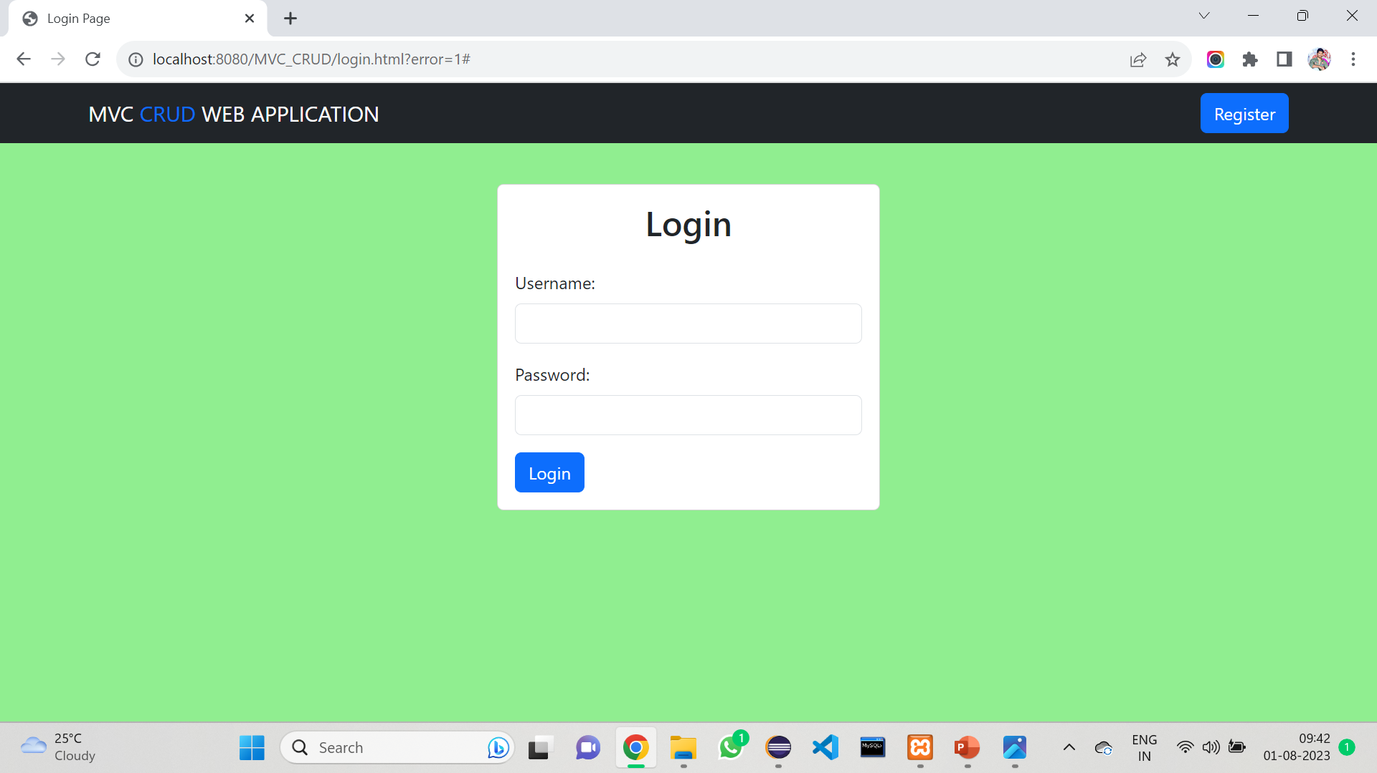

Slide 16
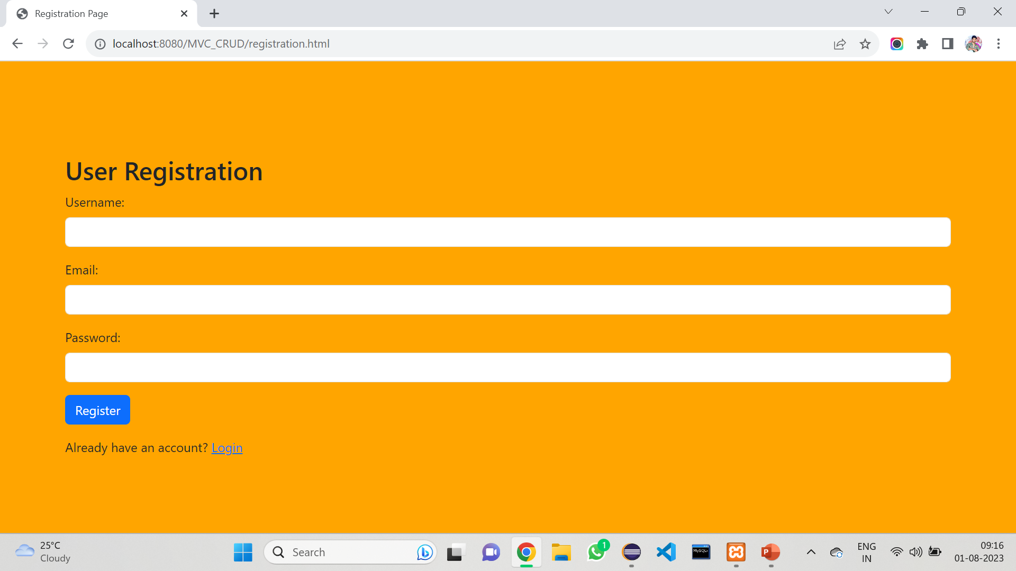

Slide 17
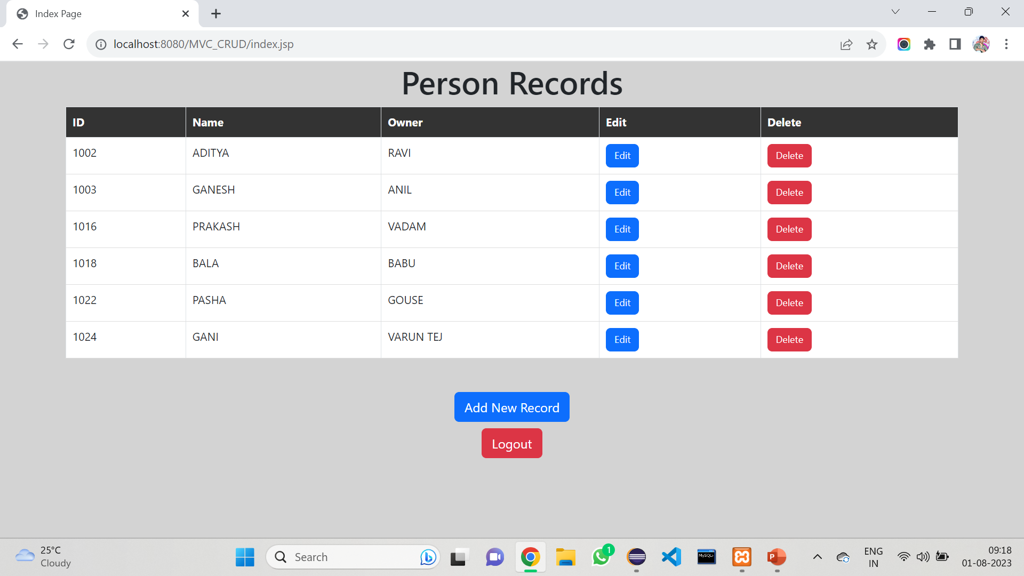

Slide 18
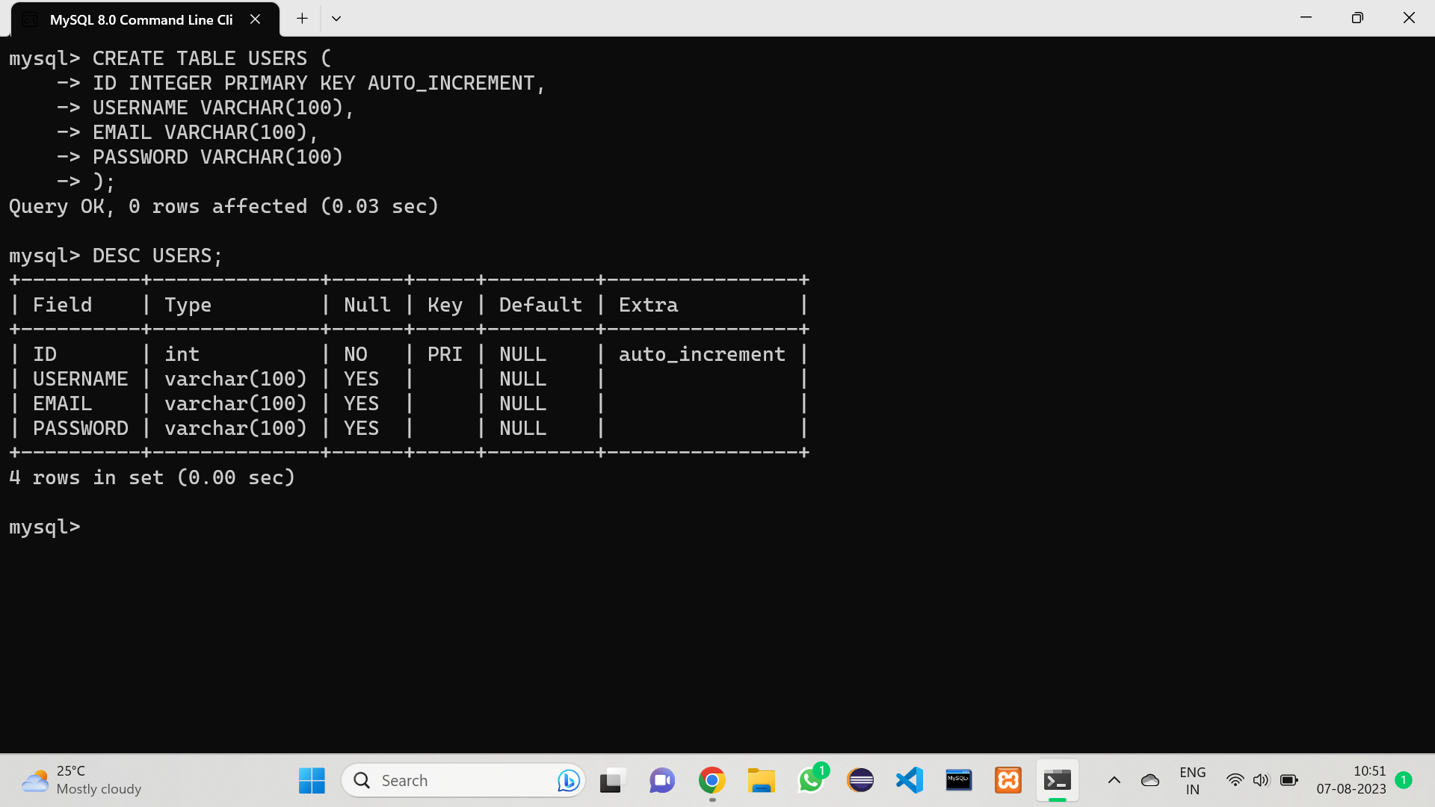

Slide 19
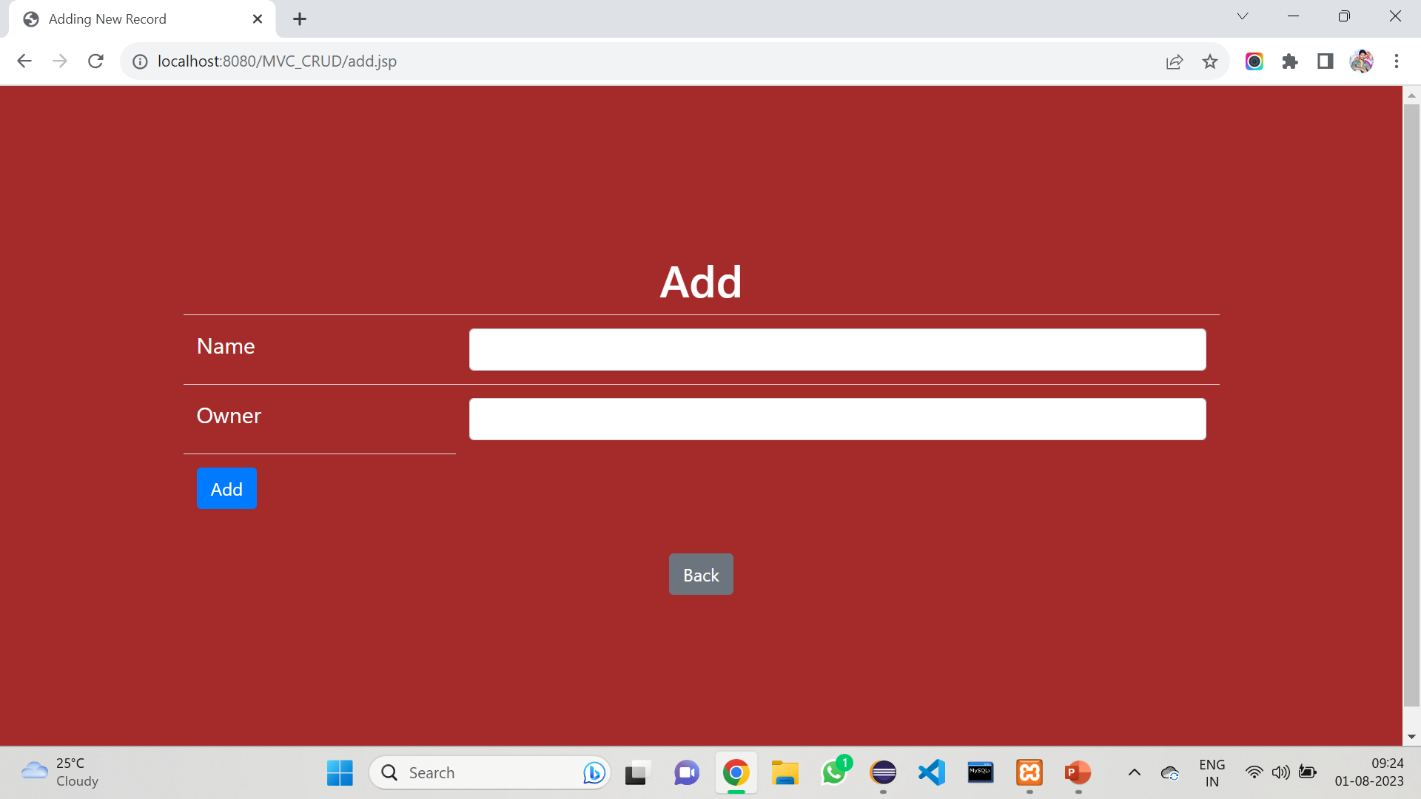

Slide 20
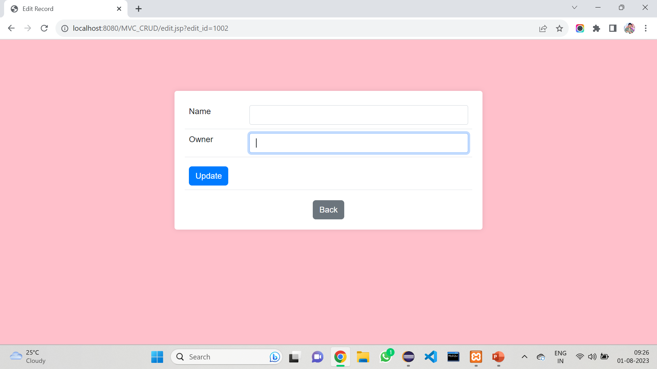

Slide 22
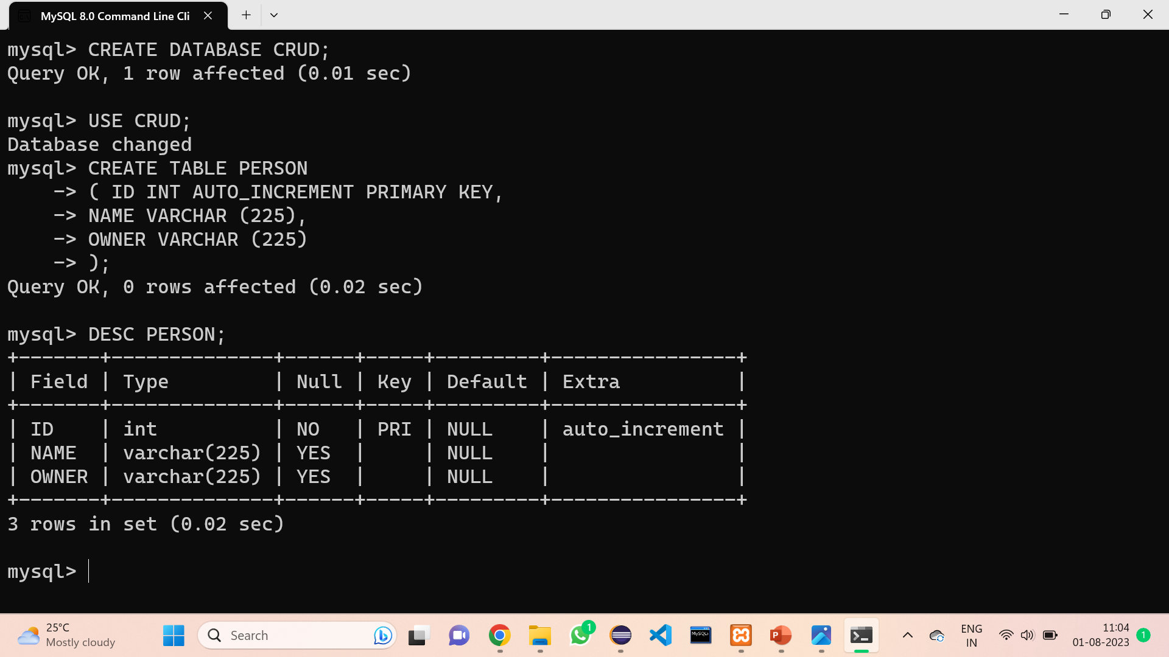

Slide 23
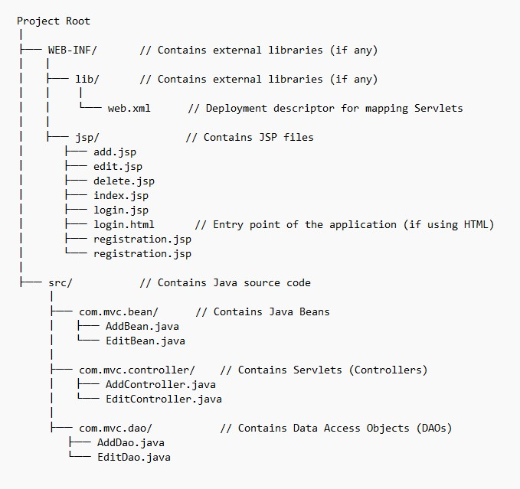
FOLDER
STRUCTURE

Slide 25
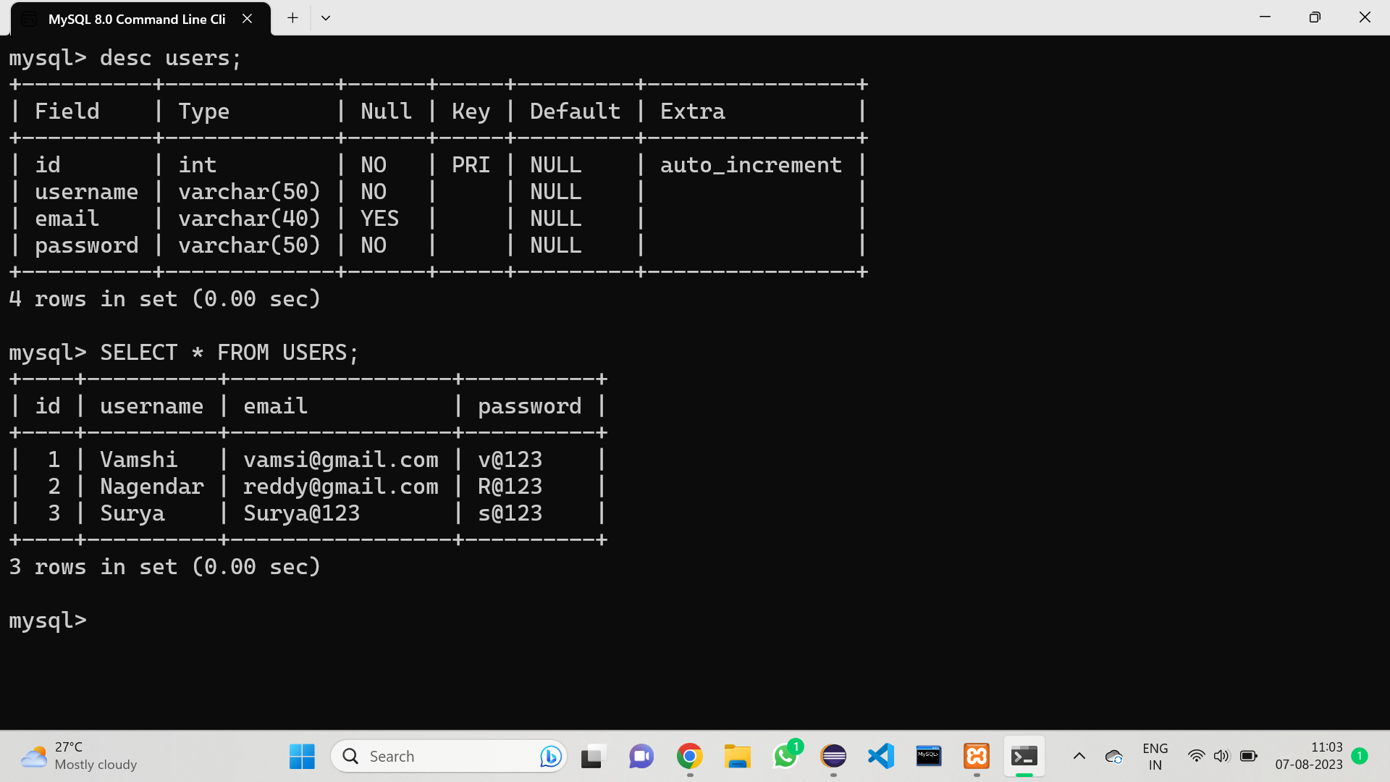

Slide 26
Registration.html
<form action="registration.jsp" method="POST">
<label for="username">Username:</label>
<input type="text" id="username" name="username" required><br>
<label for="email">Email:</label>
<input type="email" id="email" name="email" required><br>
<label for="password">Password:</label>
<input type="password" id="password" name="password" required><br>
<input type="submit" value="Register">
</form>

Slide 27
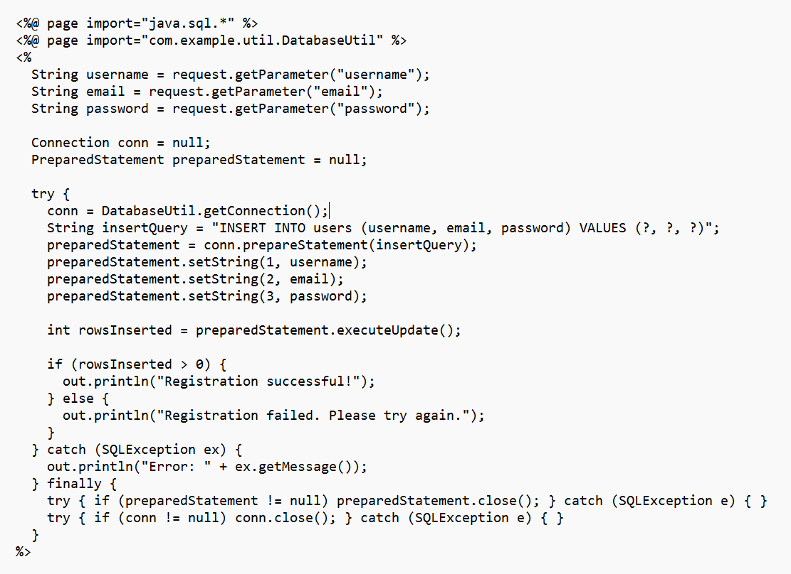

Slide 28
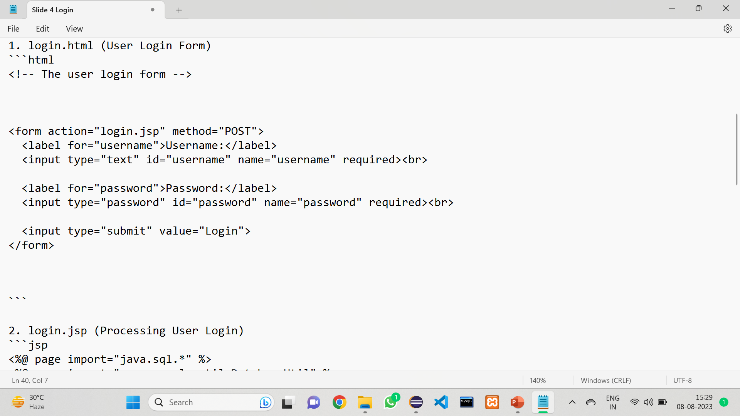
Login.html

Slide 29
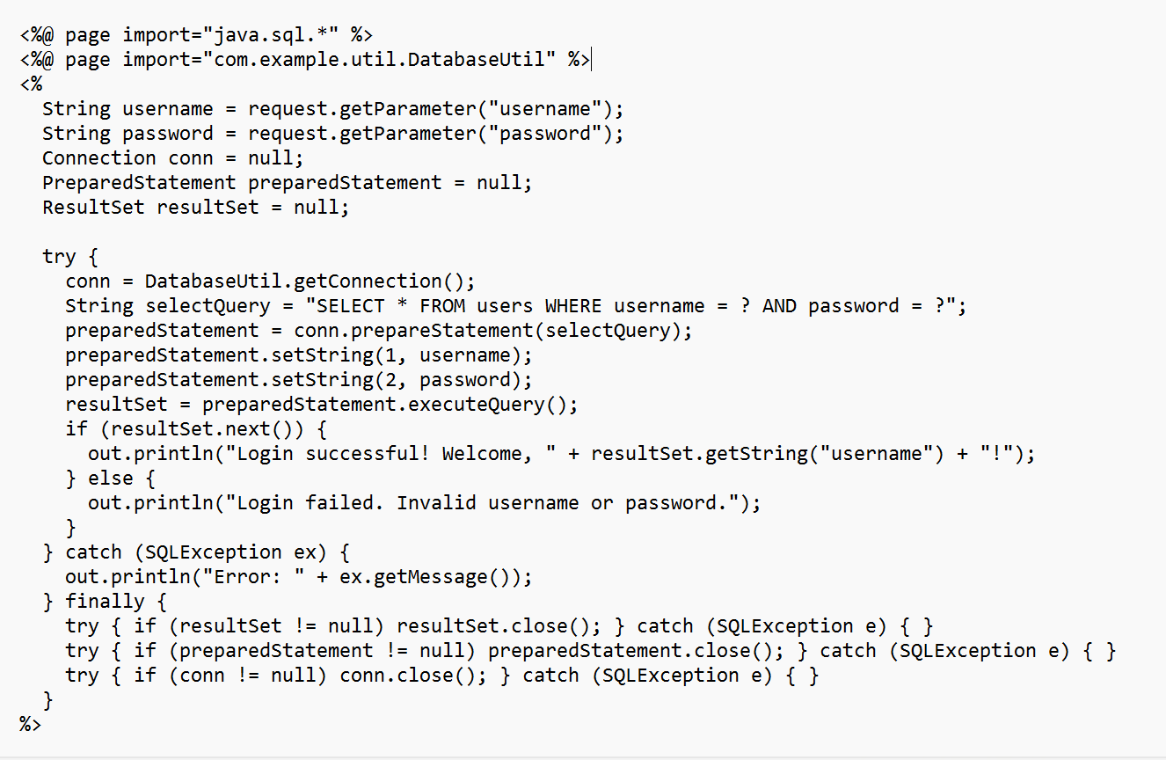
Login.jsp

Slide 30
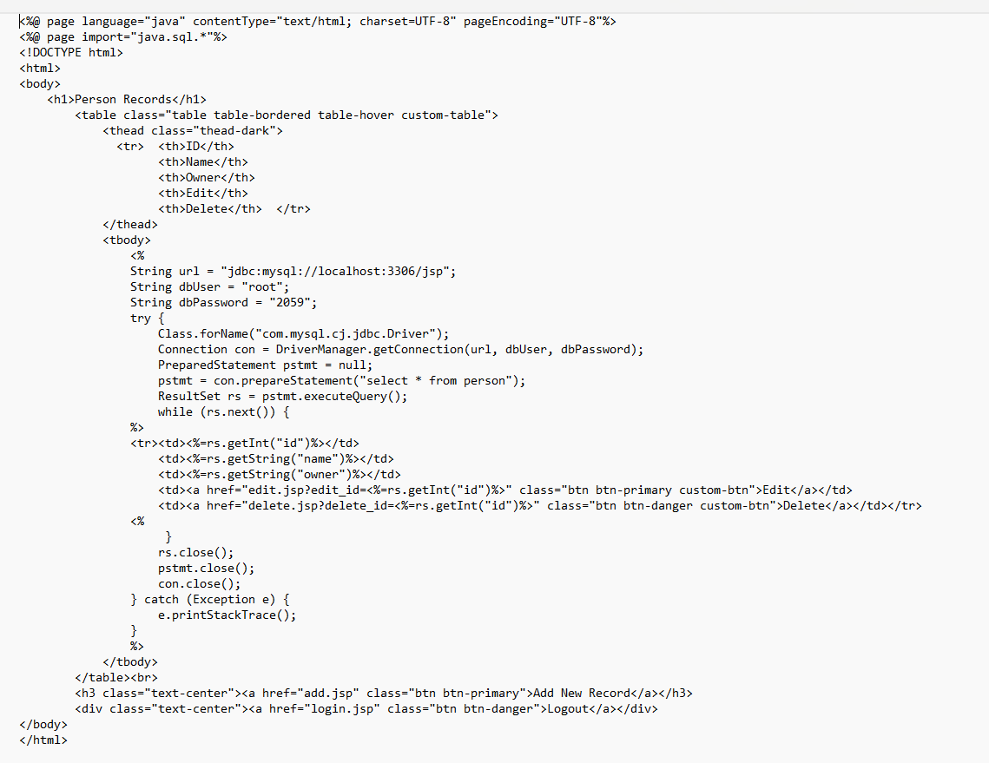
Index.jsp

Slide 31
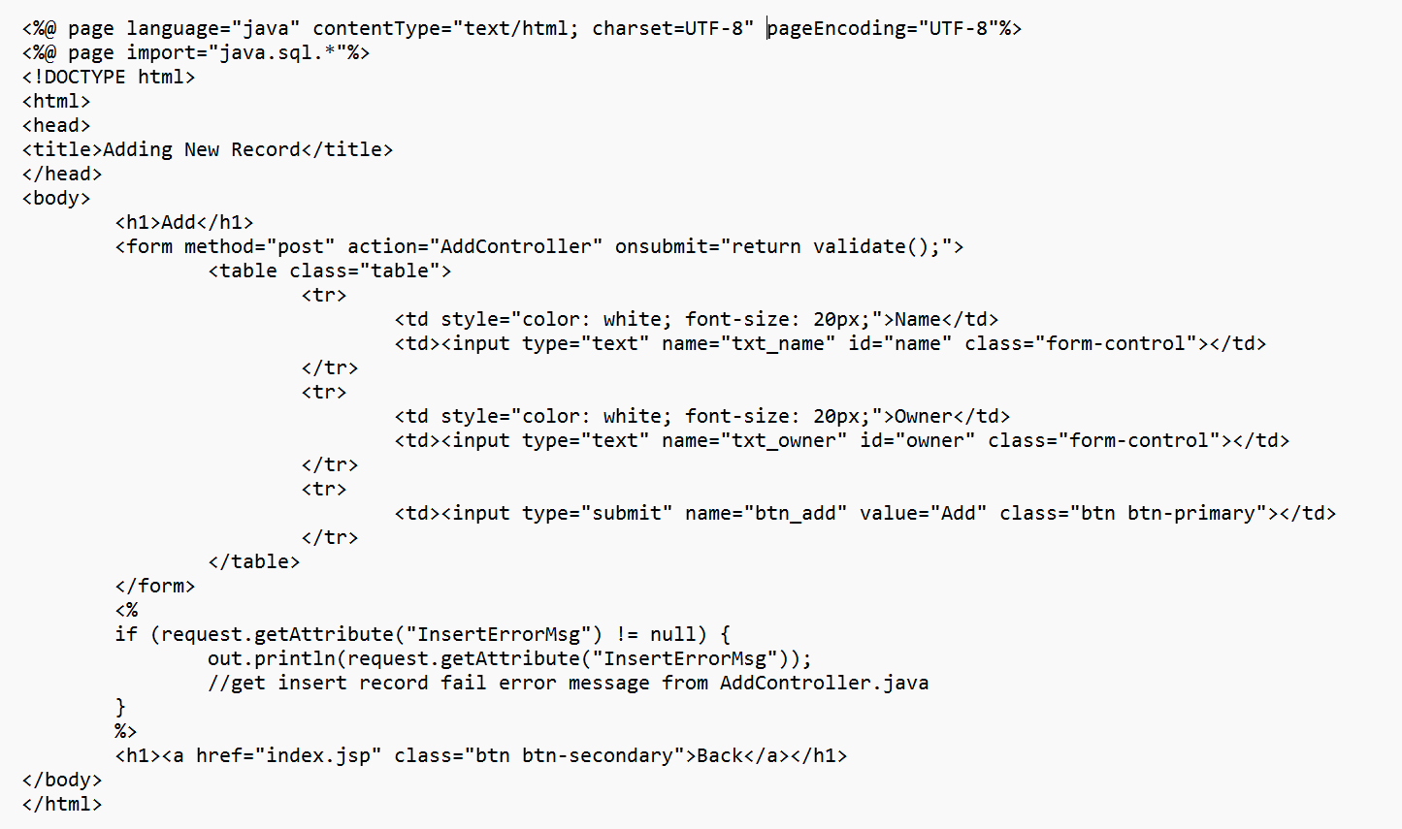
Add.jsp

Slide 32
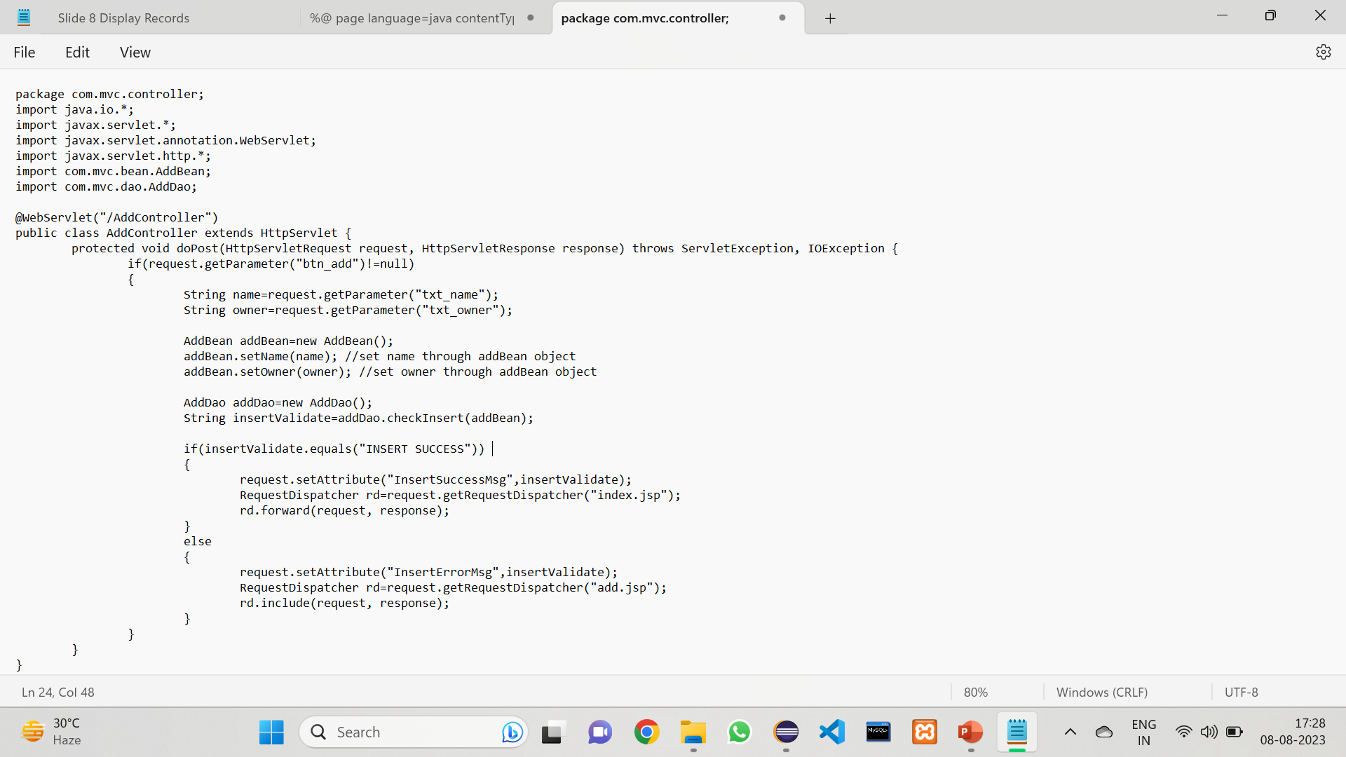
AddController.java

Slide 33
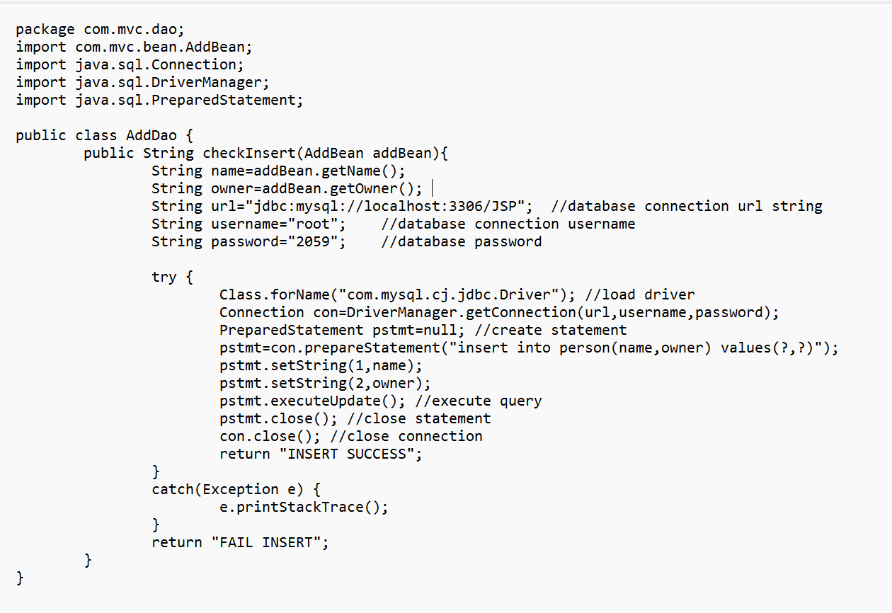
addDao.java

Slide 34
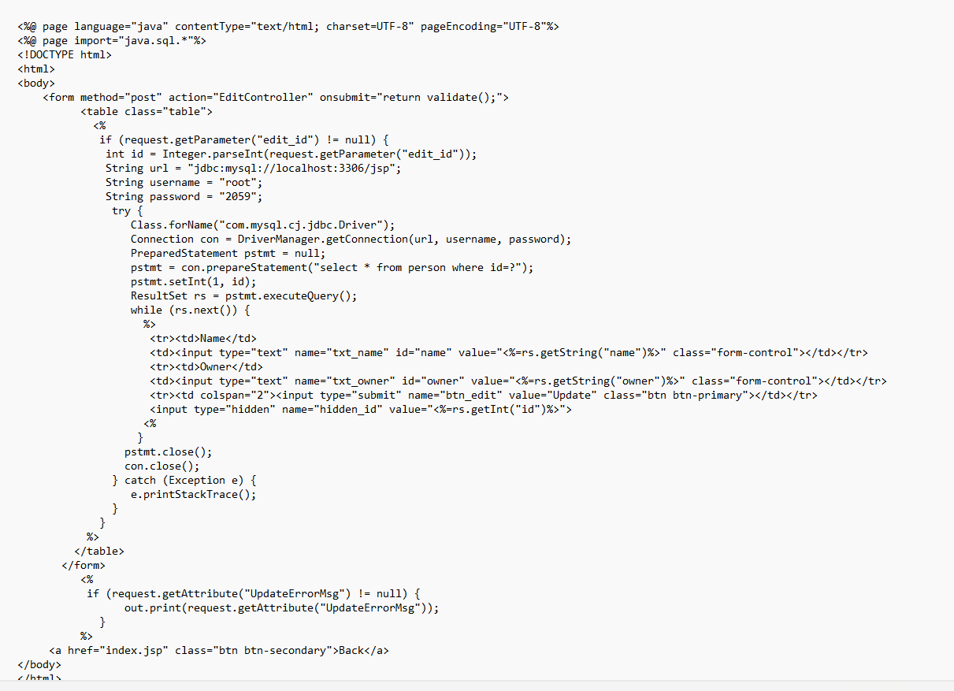
edit.jsp

Slide 35
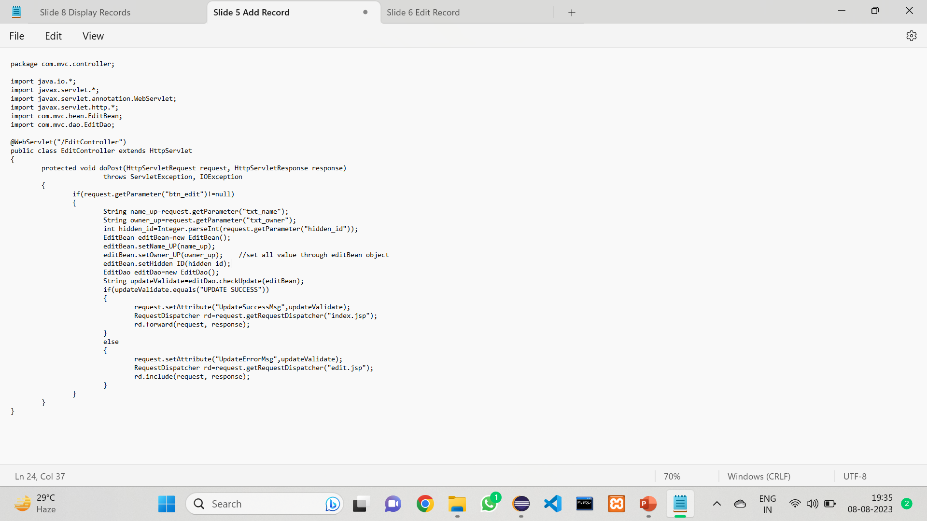
EditController.java

Slide 36
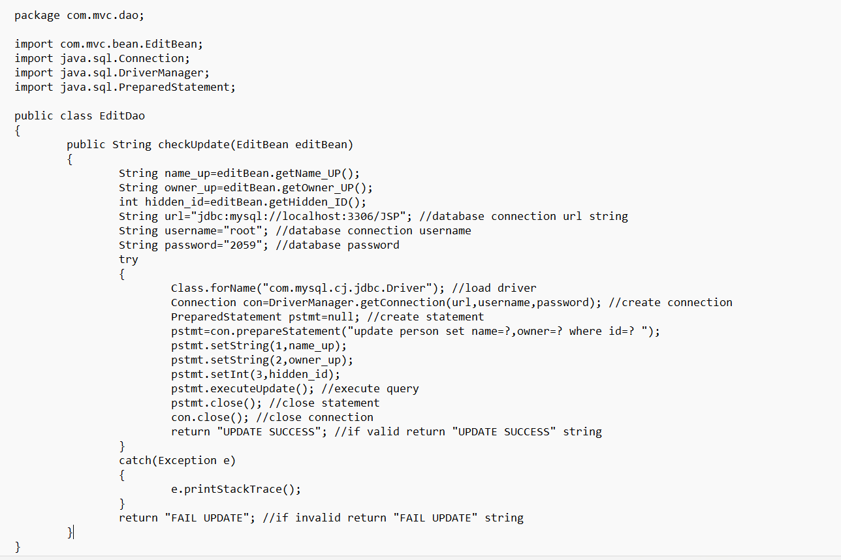
editDao.Java

Slide 37
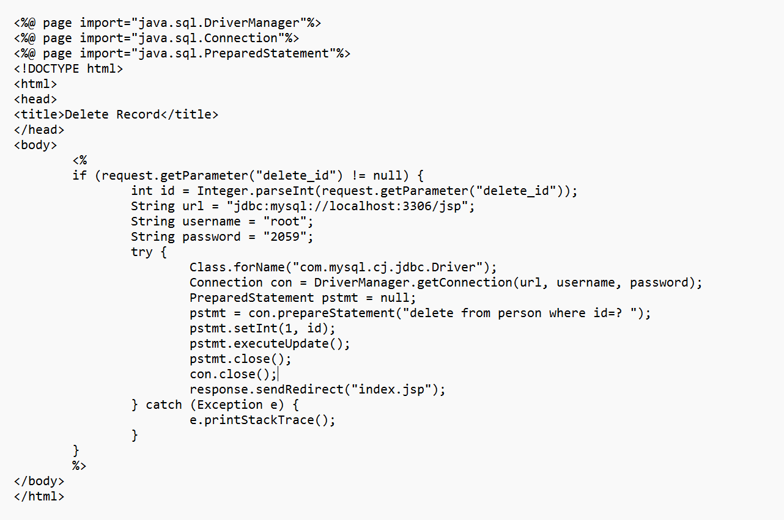
delete.jsp

Slide 38
Conclusion
In conclusion, we have successfully demonstrated the process of building a Simple CRUD Web Application using Java Servlets and JSP. Throughout this presentation, we covered the key functionalities of the application, allowing users to register, log in, add, edit, and delete records in the database. CRUD operations (Create, Read, Update, Delete) are fundamental for managing data in a database, and our application effectively implements these operations.
Java Servlets and JSP have proven to be a powerful combination for developing dynamic web applications. Servlets handle server-side requests and responses, while JSP enables us to generate dynamic HTML content. With the help of MySQL as the database management system and JDBC for database connectivity, we have seamlessly integrated the front-end and back-end components.
By following this presentation, developers can gain a solid foundation for building more complex web applications and extend this basic structure to cater to specific project requirements. The ability to manage data effectively and provide a user-friendly interface is crucial for modern web applications, and Java Servlets and JSP offer a reliable solution for achieving these goals. Thank you for joining us on this journey to create a Simple CRUD Web Application using Java Servlets and JSP.

